Slide 1
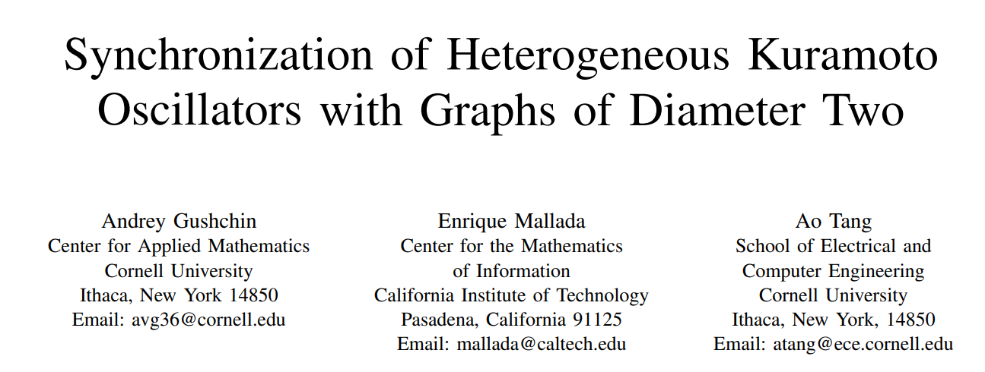
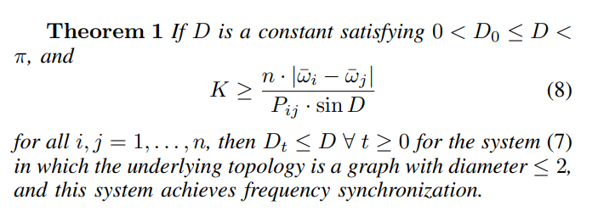
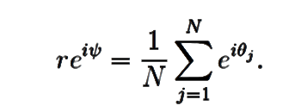
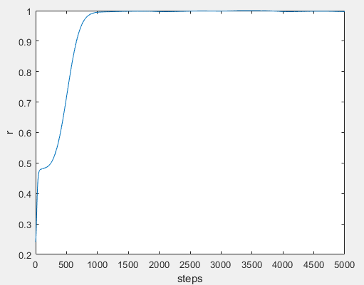
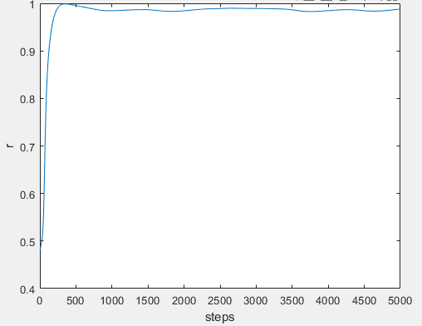
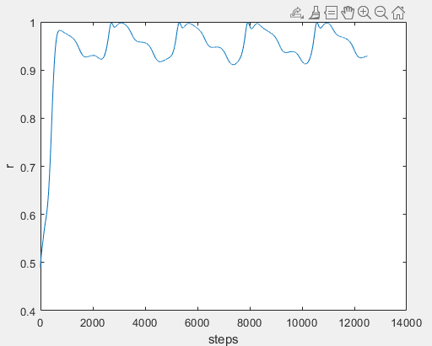
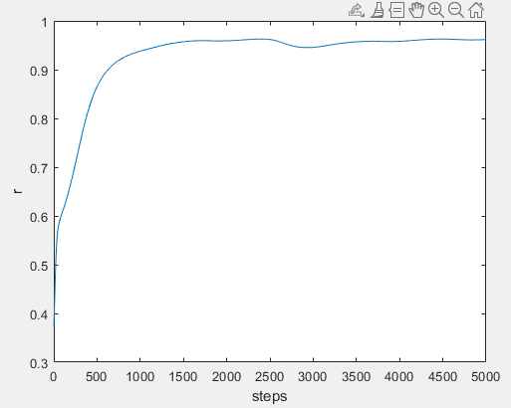
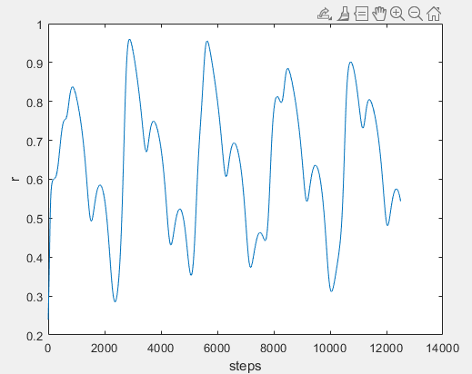
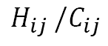
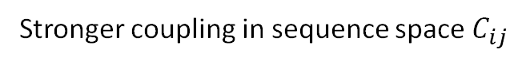
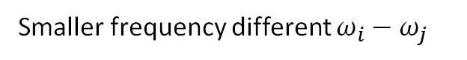
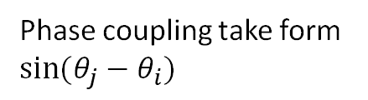
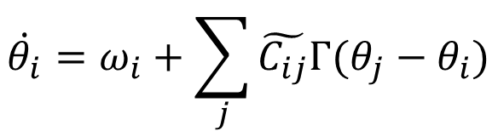
Phase coupling take form $sin⁡(θ_{j}−θ_{i})$
frequency Synchronization
$$\dot{θ_{i}}=ω_{i}+\sum_{j}{\tilde{C_{ij}}Γ(θ_{j}−θ_{i})}$$
Temporal frequency
Reduced covariance matrix
Smaller frequency different $ω_{i}−ω_{j}$
Stronger Synchronization
Stronger coupling in sequence space $C_{ij}$
threshold for synchronization？
$$H_{ij} /C_{ij}$$
2020-09
(initial phase from random)
with site 69, 70, 570
with site 69, 70, 570,1118,681
with site 69, 70, 570,1118,681,144
with site 69, 70, 570,1118,681,144,
80, 484
with site 69, 70, 570,1118,681,
144, 80,484,141,142,143

Slide 2
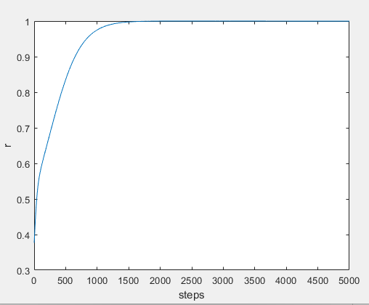
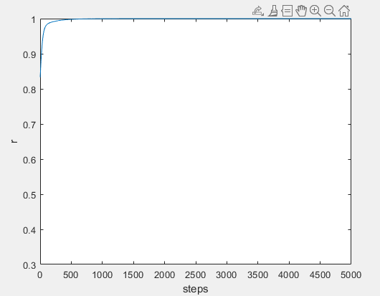
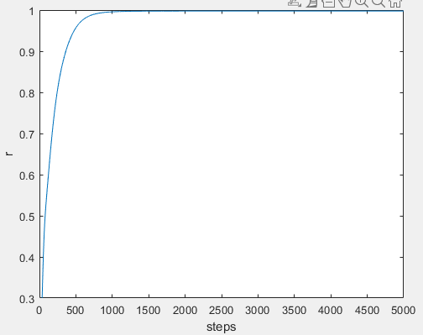
Start from cluster H69, V70, N501 optimise r
H69, V70, N501
[69,70,501,570]
[69,70,501,75,439,222,614,681,716,1027,1073,1118]

Slide 3
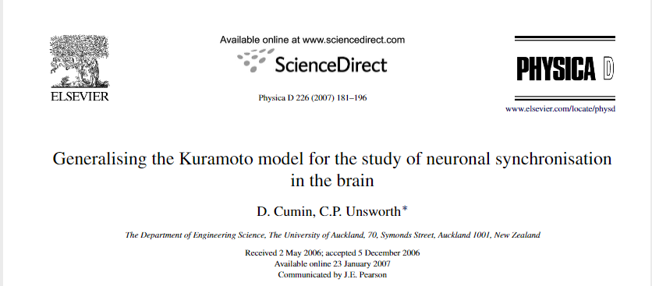
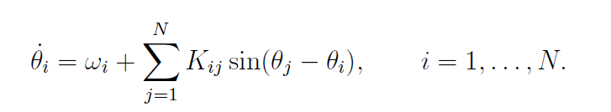
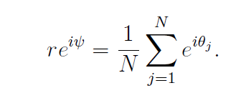
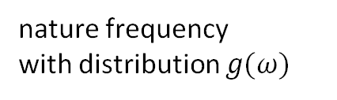
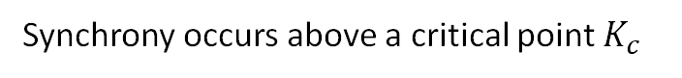
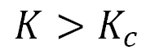
N coupled phase oscillators
coupling is sufficiently weak
$$K>K_{c}$$
Synchrony occurs above a critical point $K_{c}$
phase
nature frequency
with distribution $g(ω)$
coupling
order parameter r (to visualise synchronisation of oscillators)

Slide 4
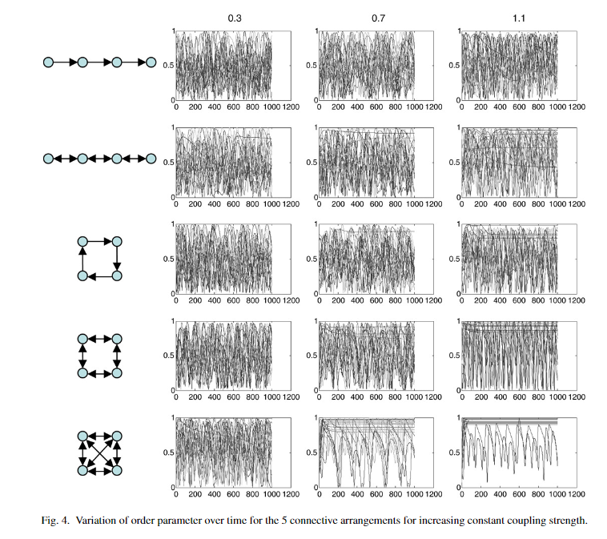
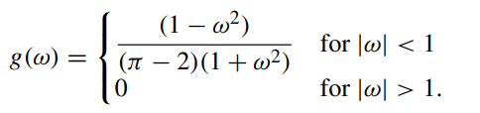
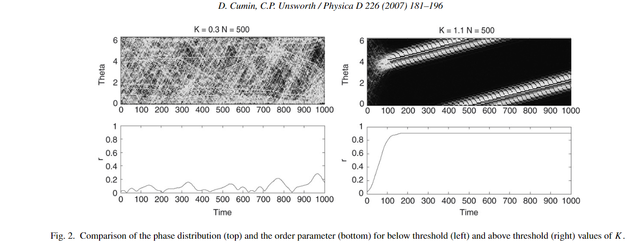

Slide 5
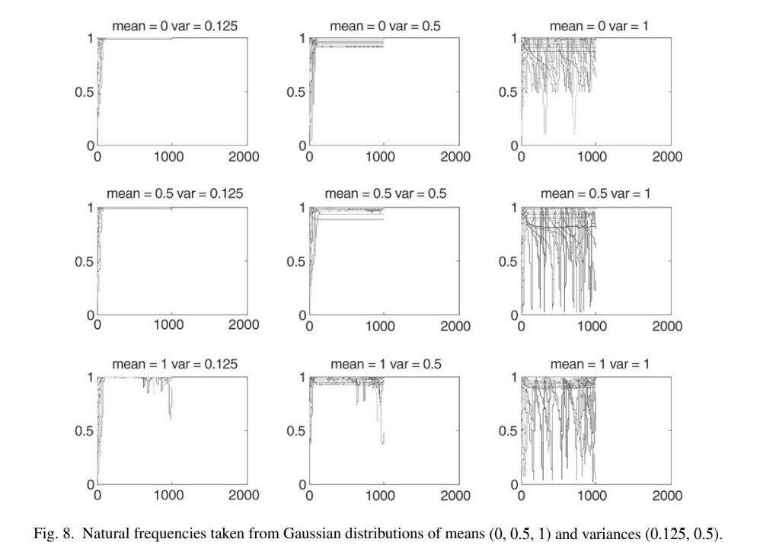
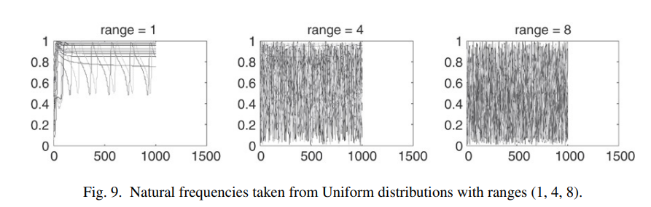
Change distribution of nature frequency

Slide 6
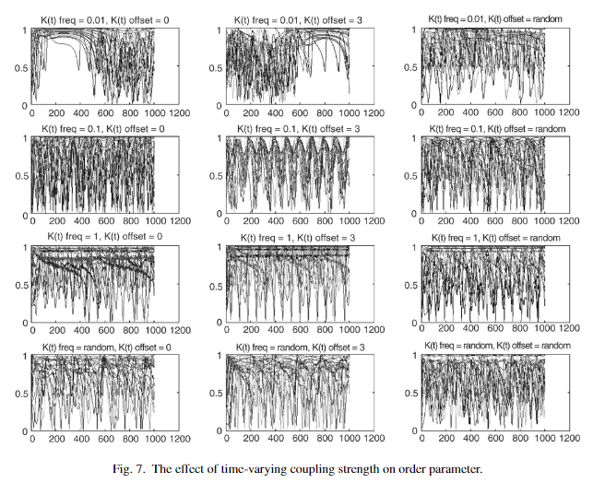
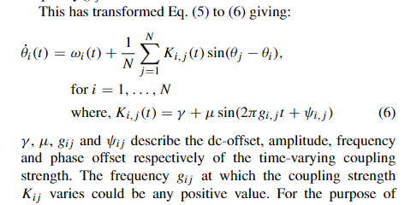
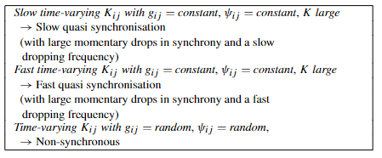
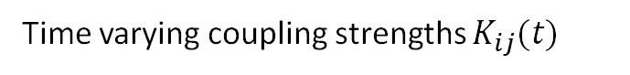
Time varying coupling strengths $K_{ij}(t)$
In the brain, the coupling strength would be governed bysynaptic changes such as the diffusion of the neurotransmitter. These changes would occur over long timescales (namely slowvarying changes in frequency)

Slide 7
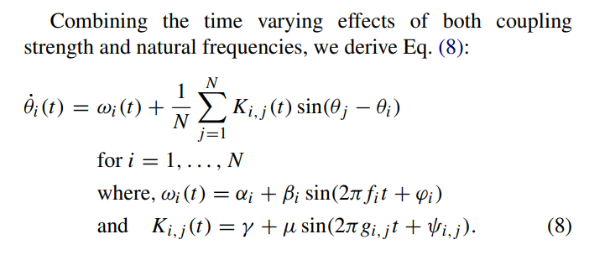
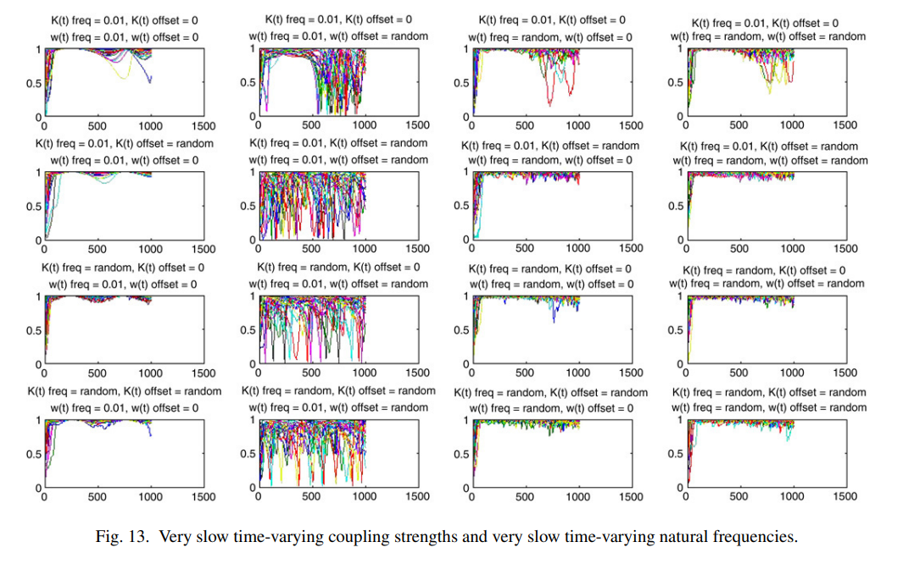
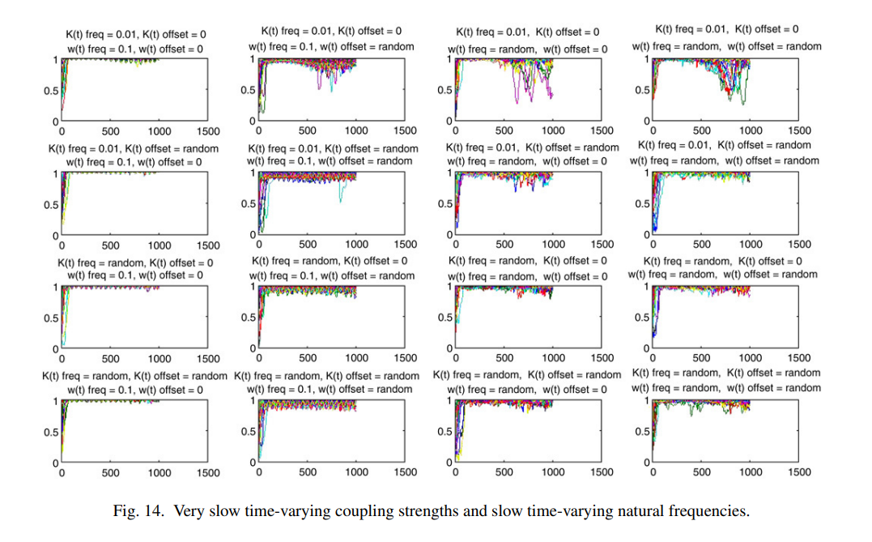

Slide 8
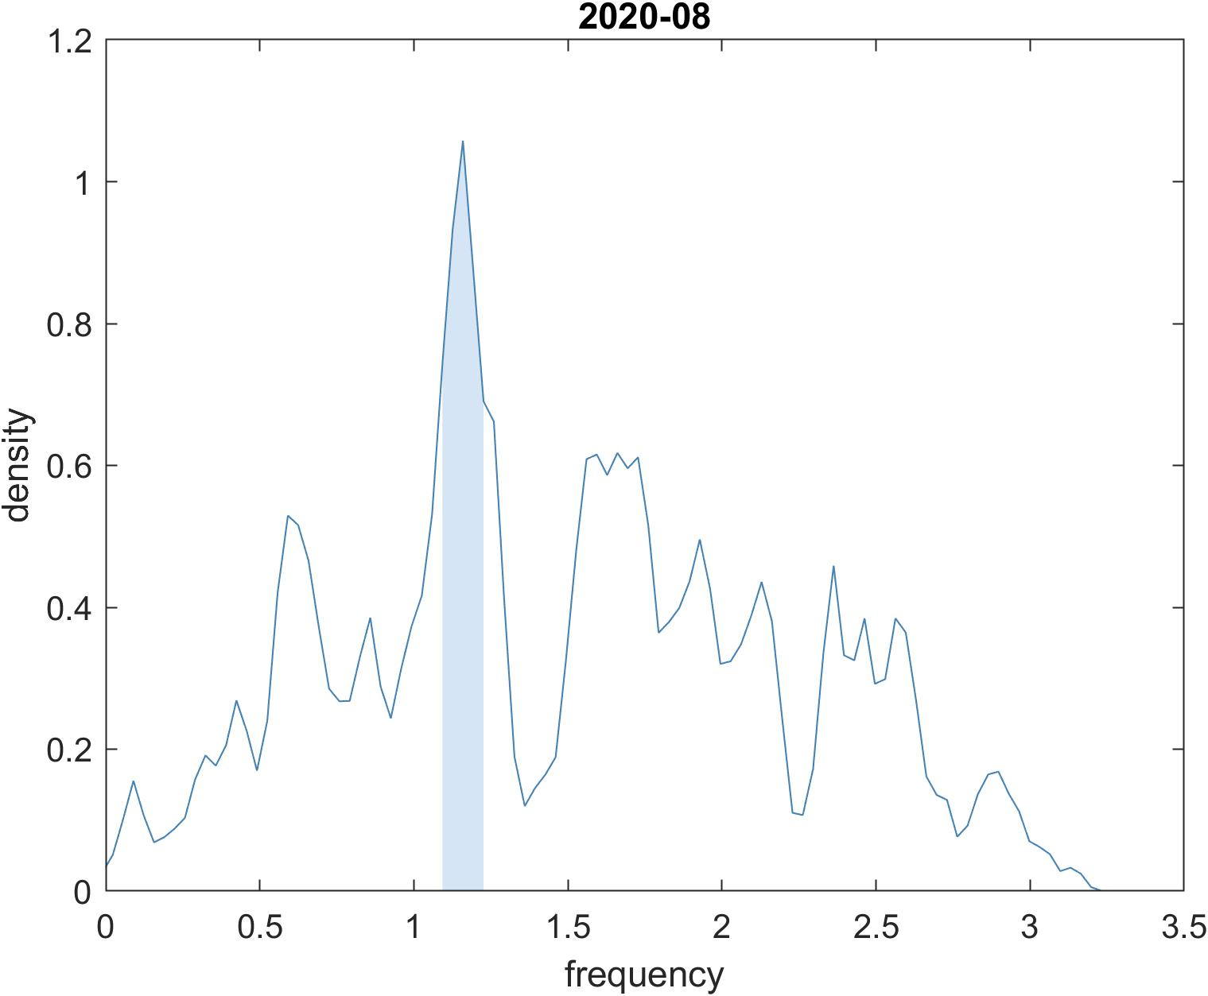
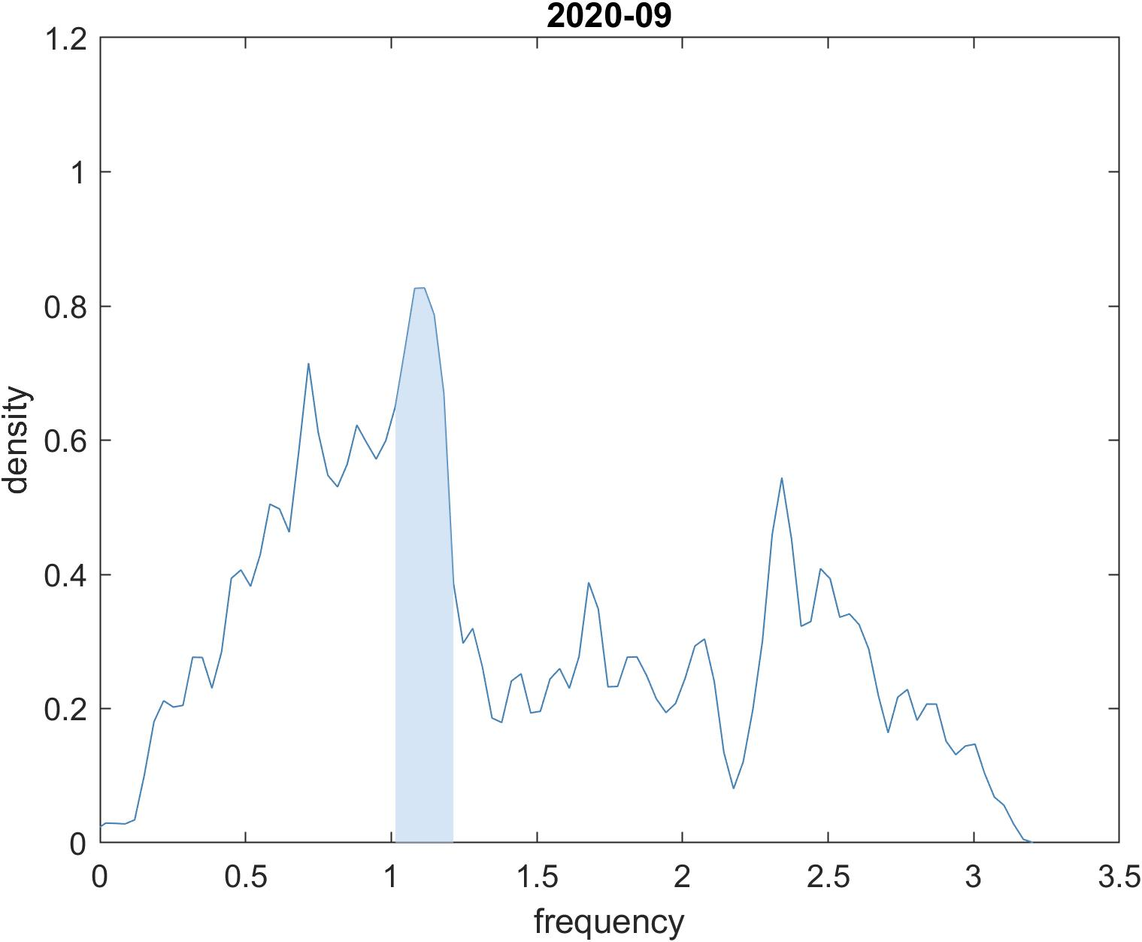
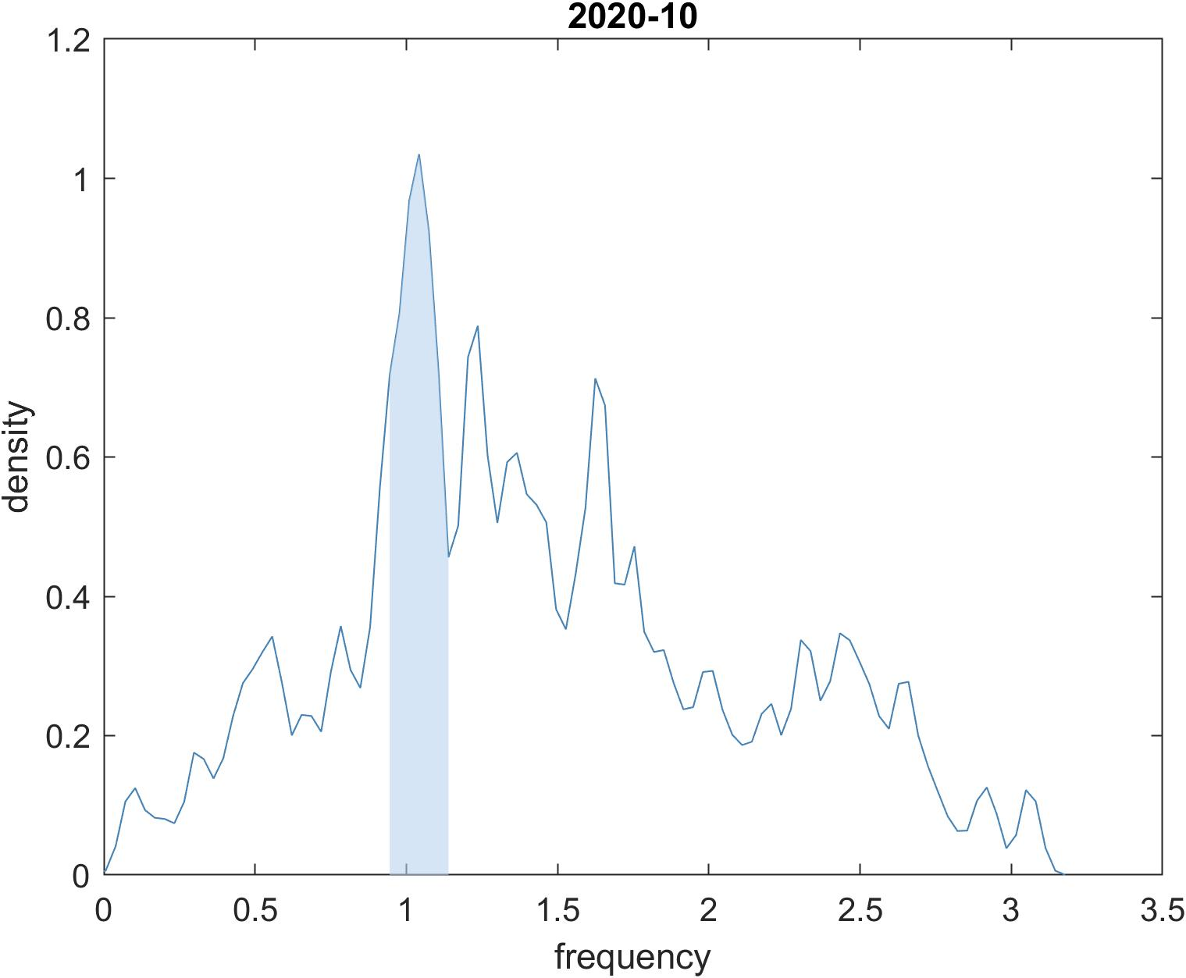
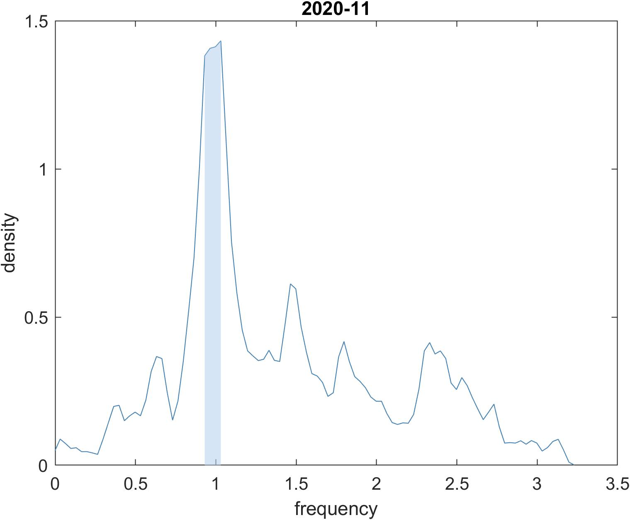
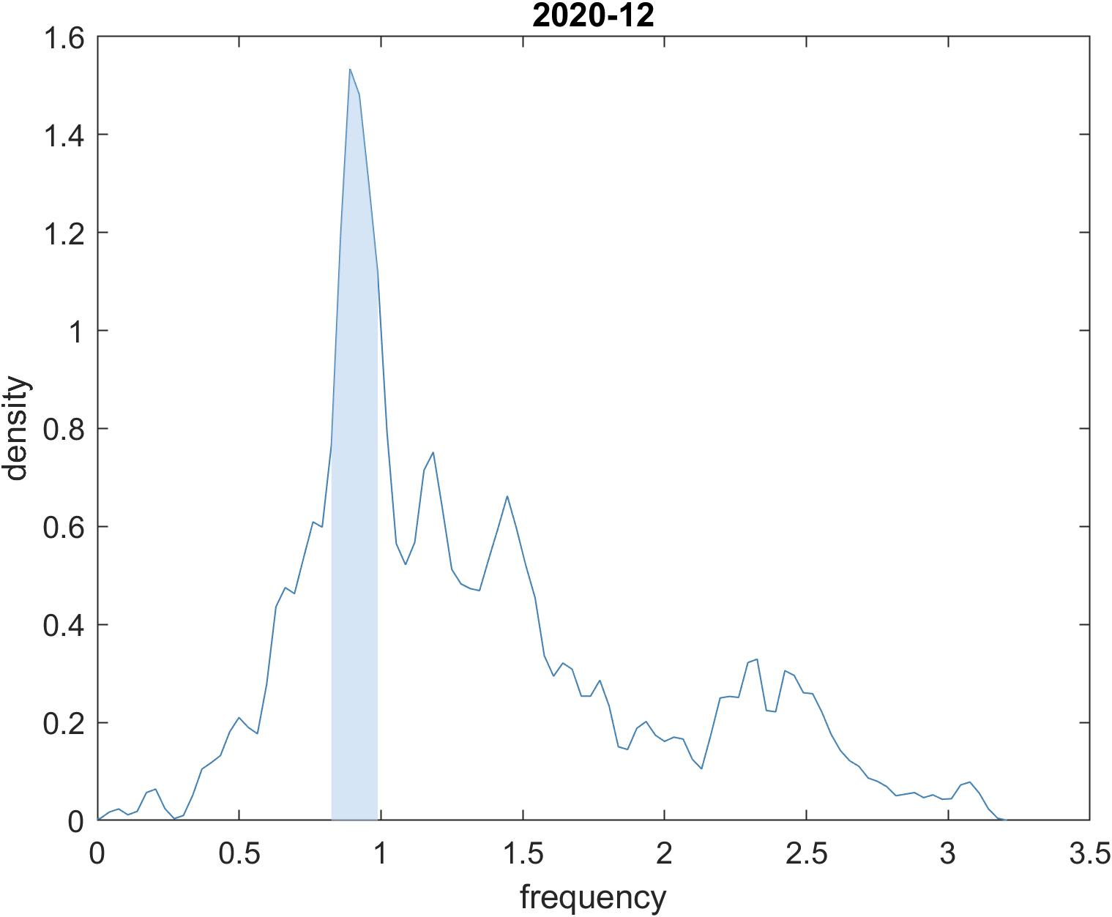
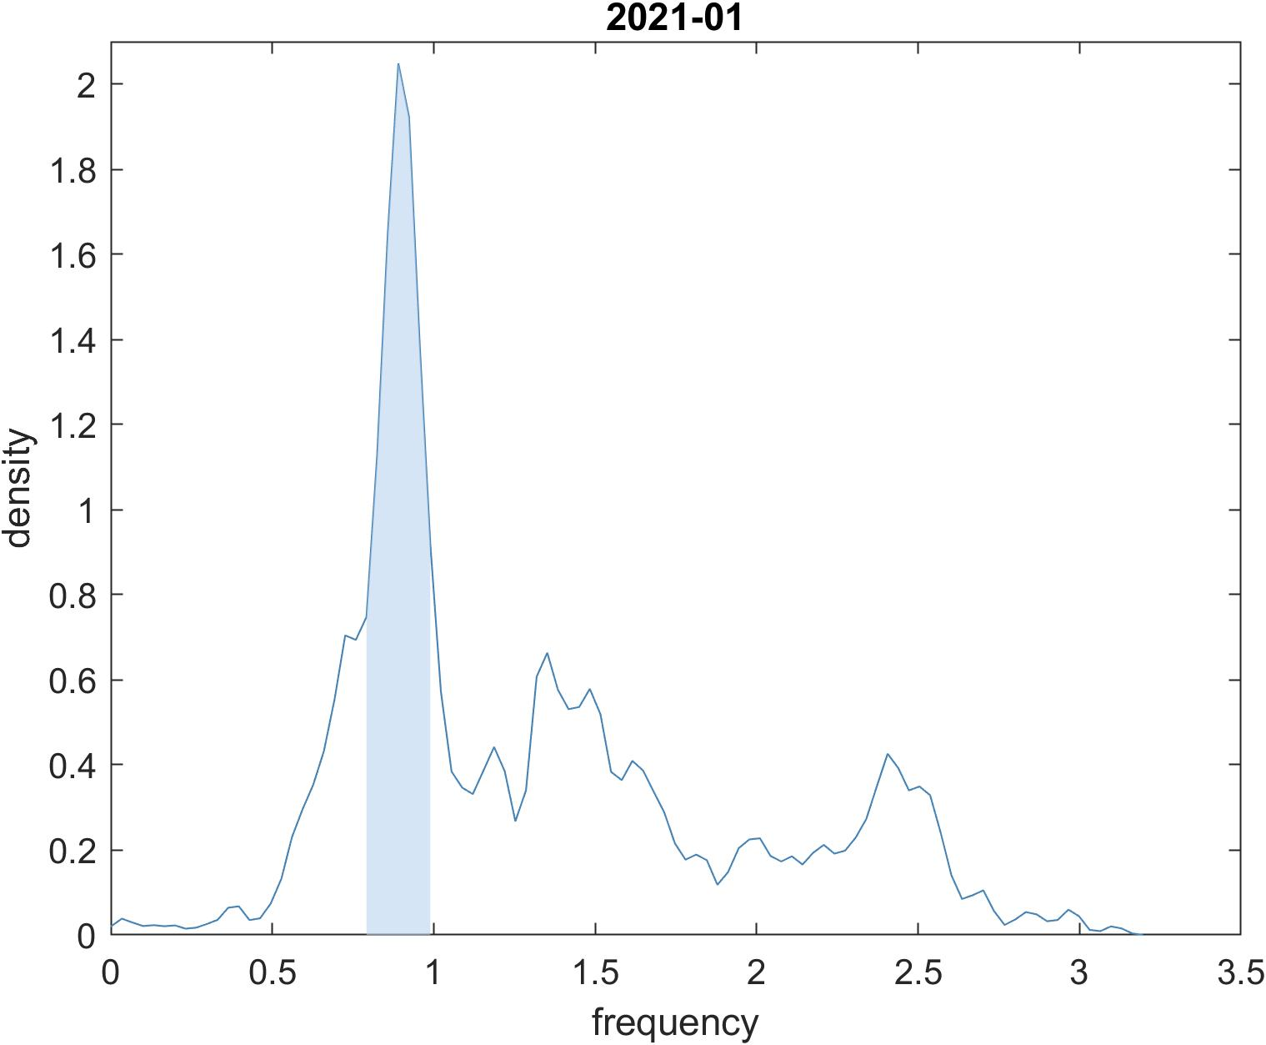
width=6*bandwidth
1.159
1.042
1.100
Around 60 sites in this range, including site 69, 70, 139, 222, 439, 453, 477, 655, 681
Around 70 sites in this range, including site 69, 70, 139, 145, 156, 222, 501, 570, 716 , 950, 1118
Around 70 sites in this range, including site 69, 70, 141, 152, 222, 417, 453, 501, 570, 982, 1118
0.964
0.891
0.890
around 90 sites, including sites 452
around 110 sites, including sites 156, 157, 452, 478
around 120 sites, including sites 19, 157, 452, 478, 950

Slide 9
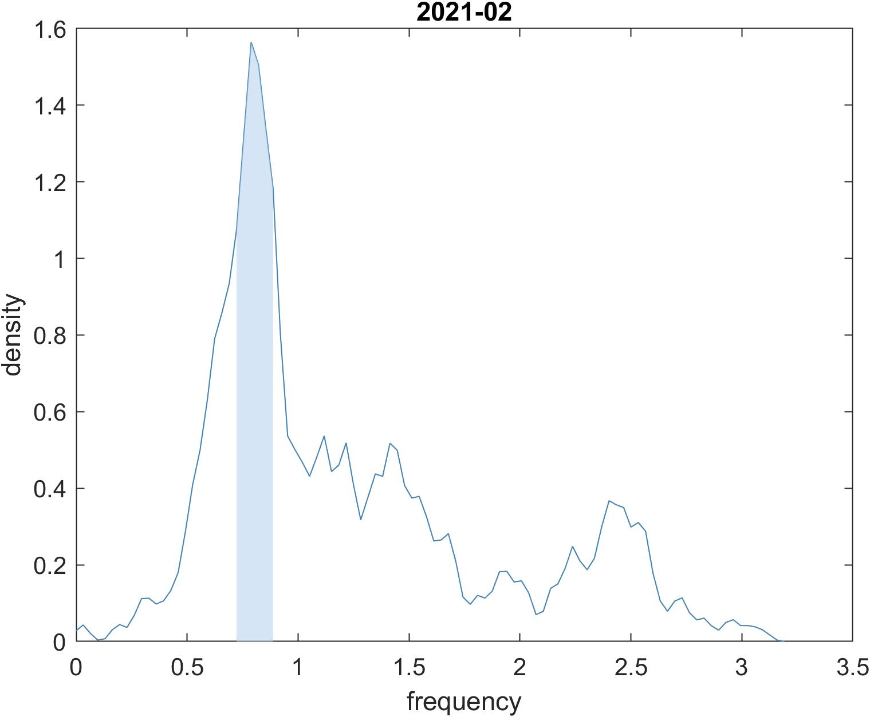
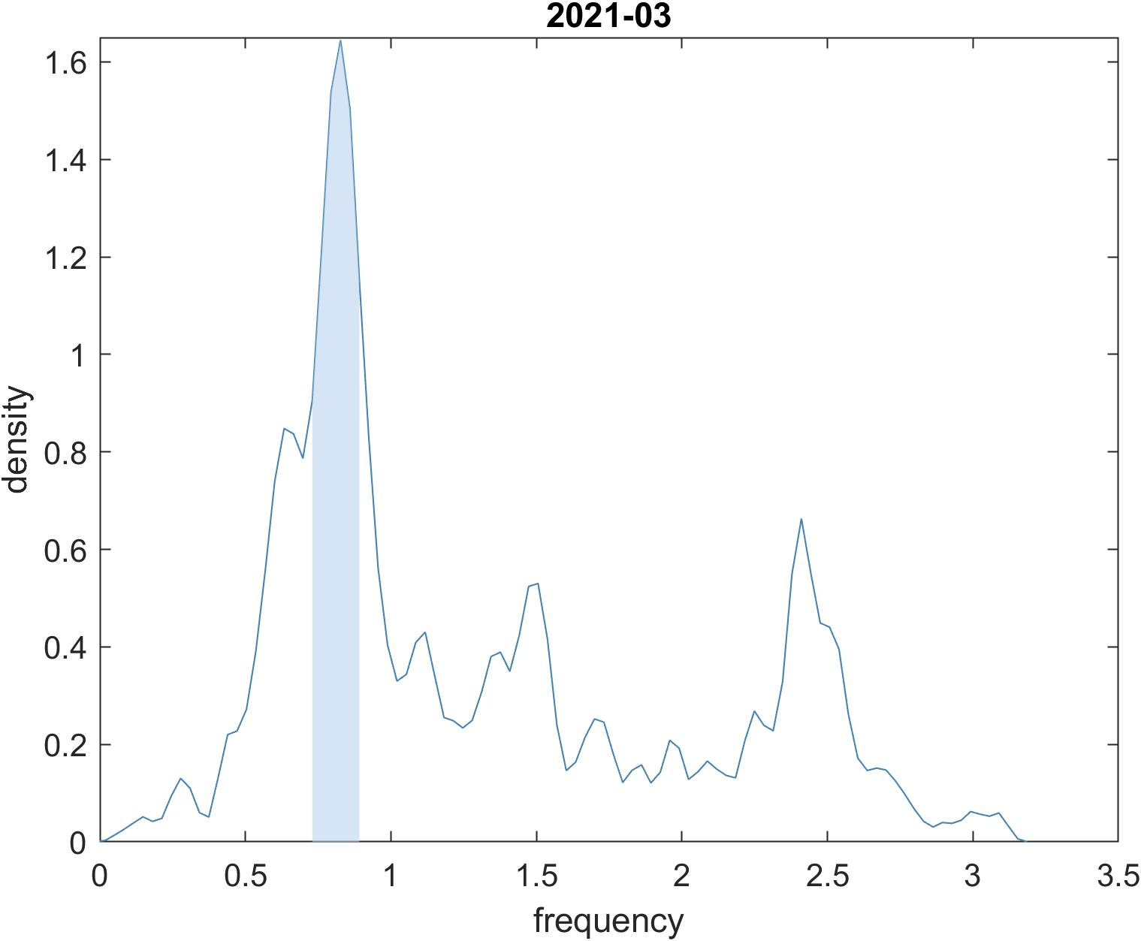
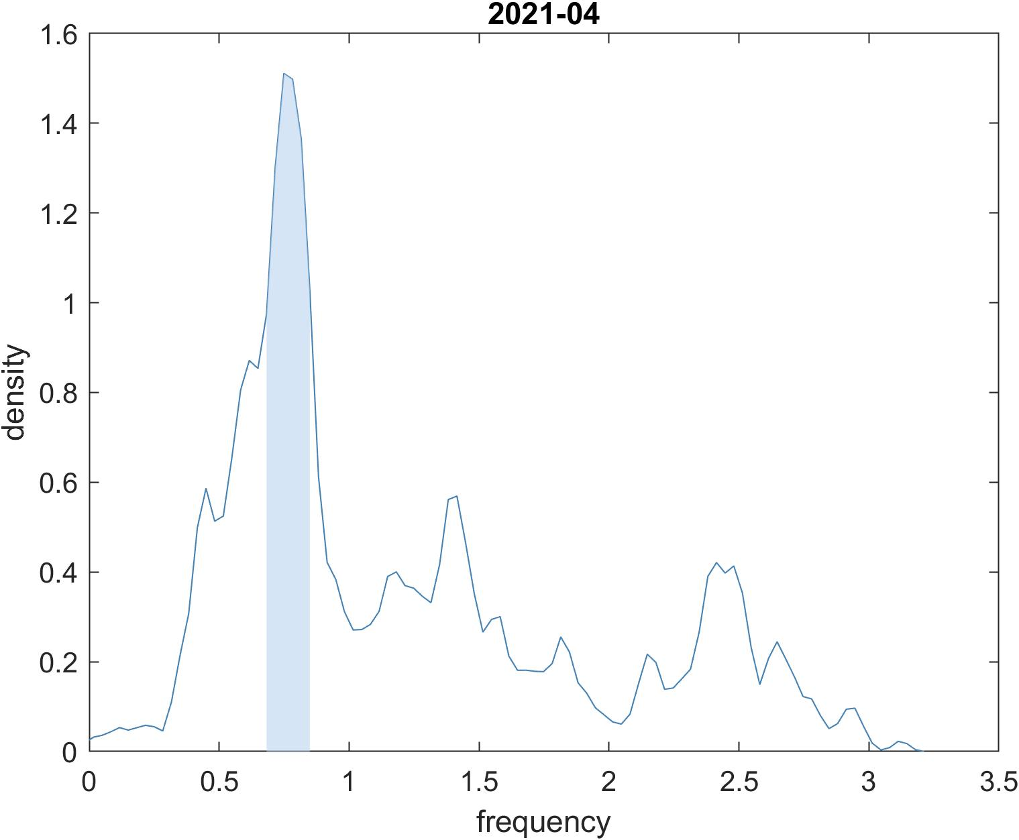
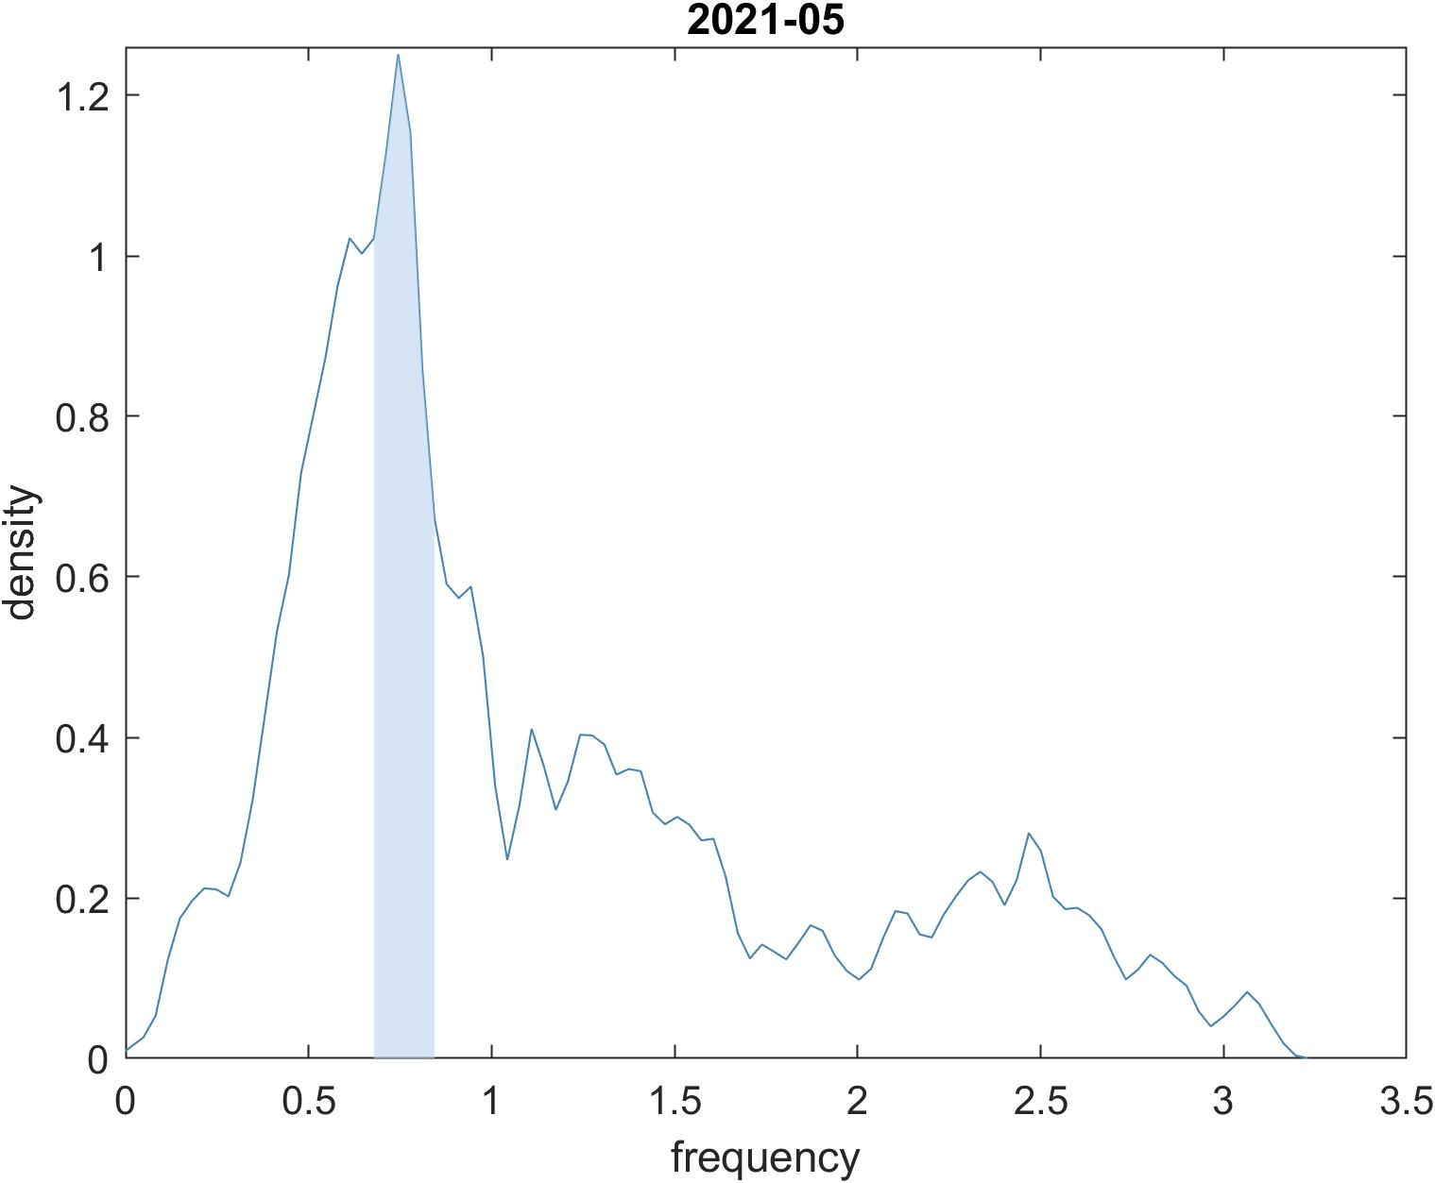
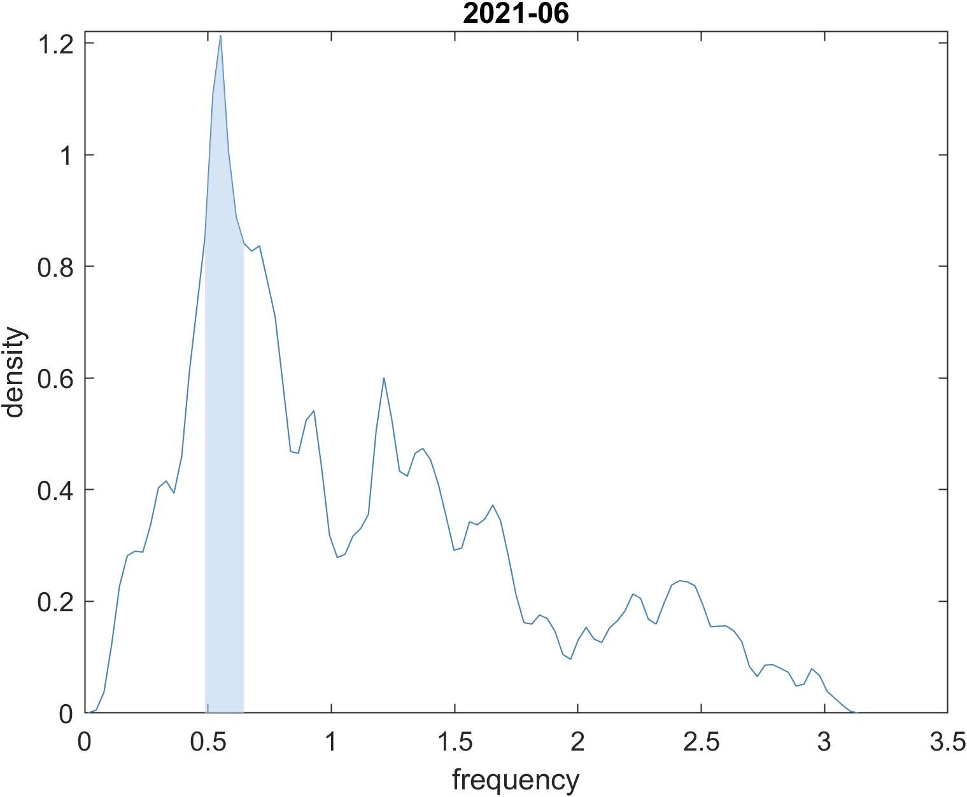
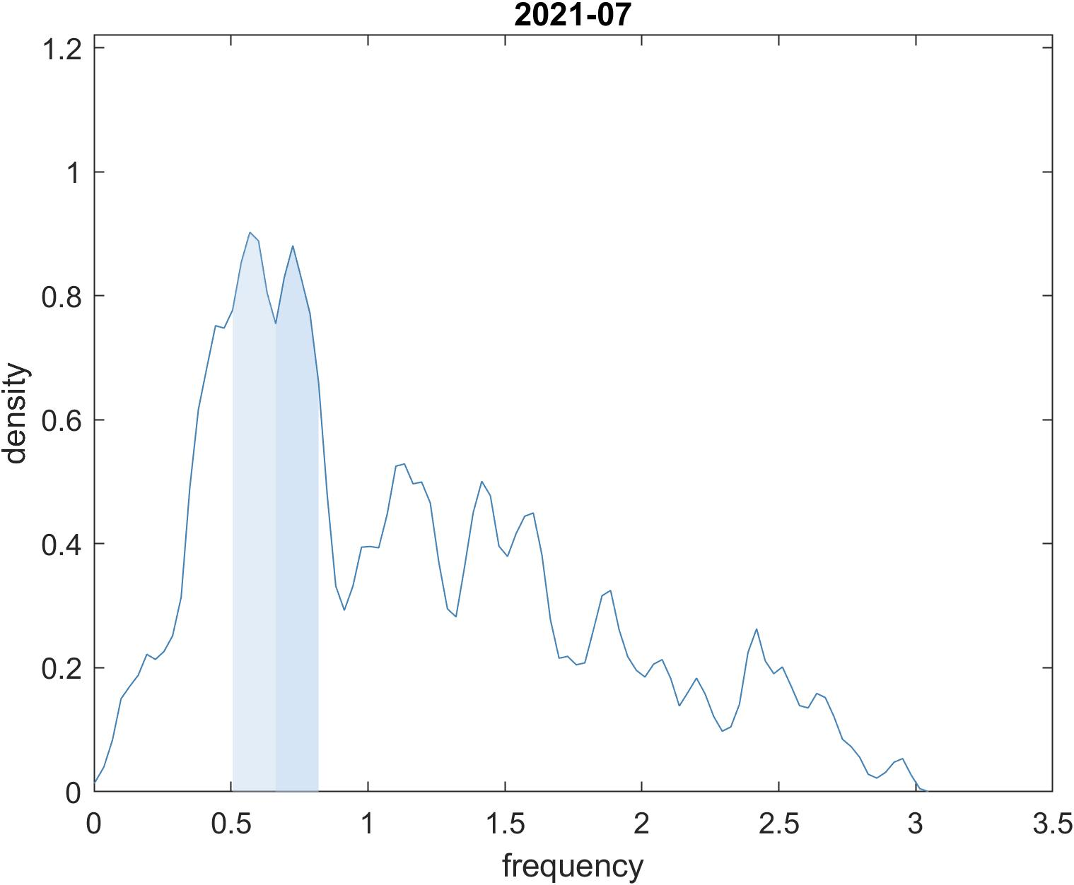
0.789
0.827
0.766
around 120 sites, including sites 19, 157, 452, 478, 950
around 120 sites, including sites 19, 156, 157, 158, 478, 950
around 100 sites, including sites 19, 156, 157, 158, 478, 950
0.745
0.551
0.569 0.726
around 110 sites
around 100 sites
delta’s sites
around 120 sites in this two range

Slide 10
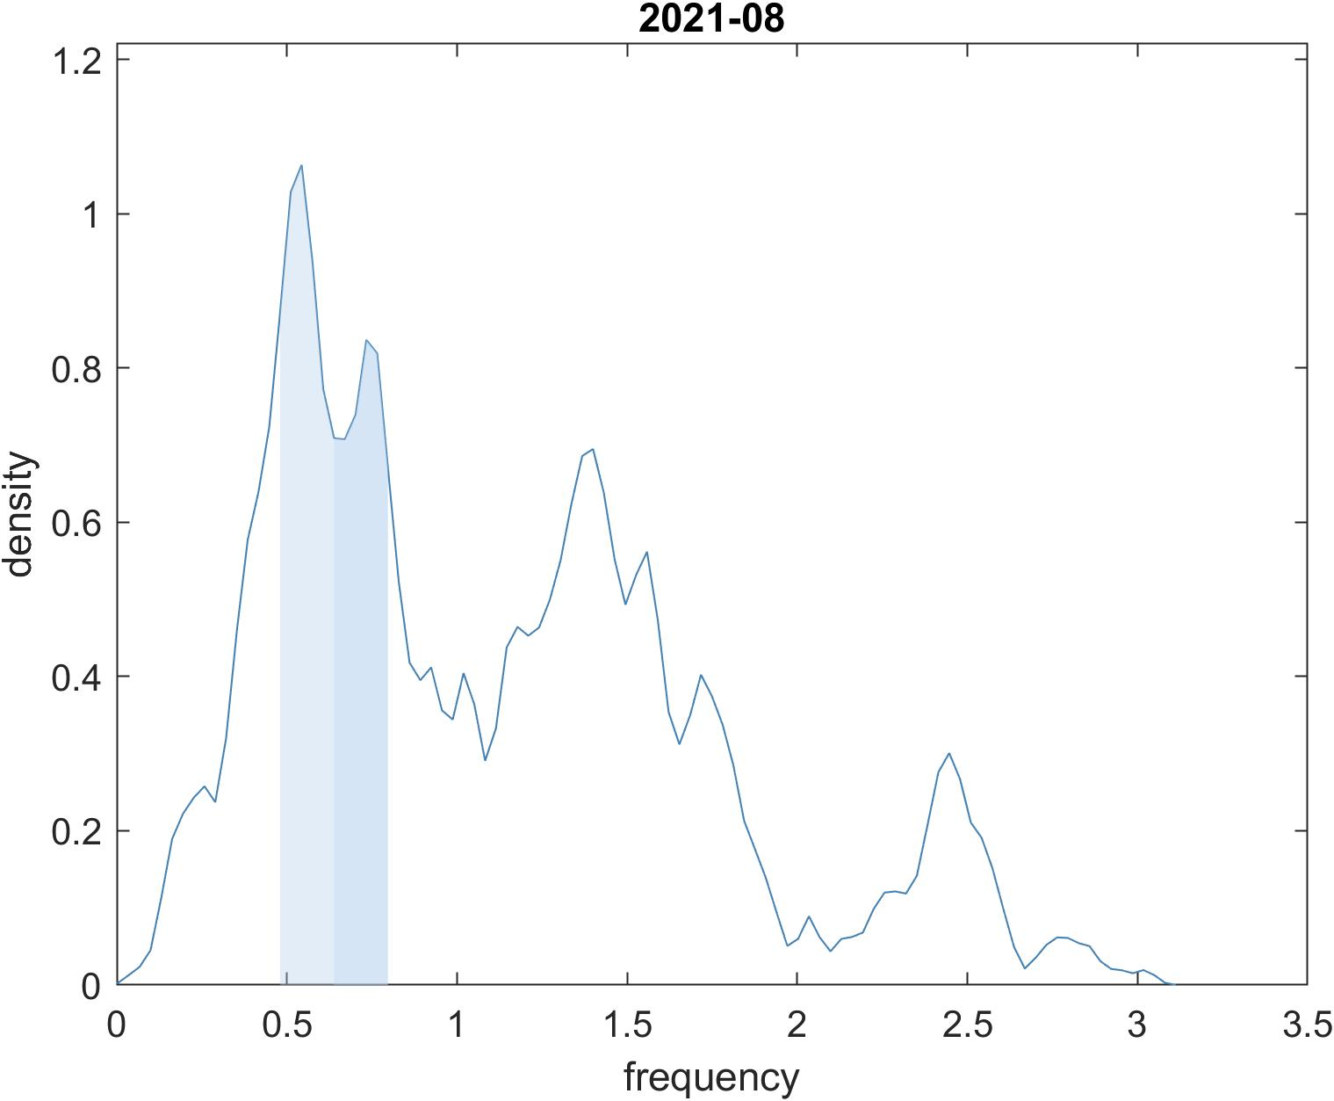
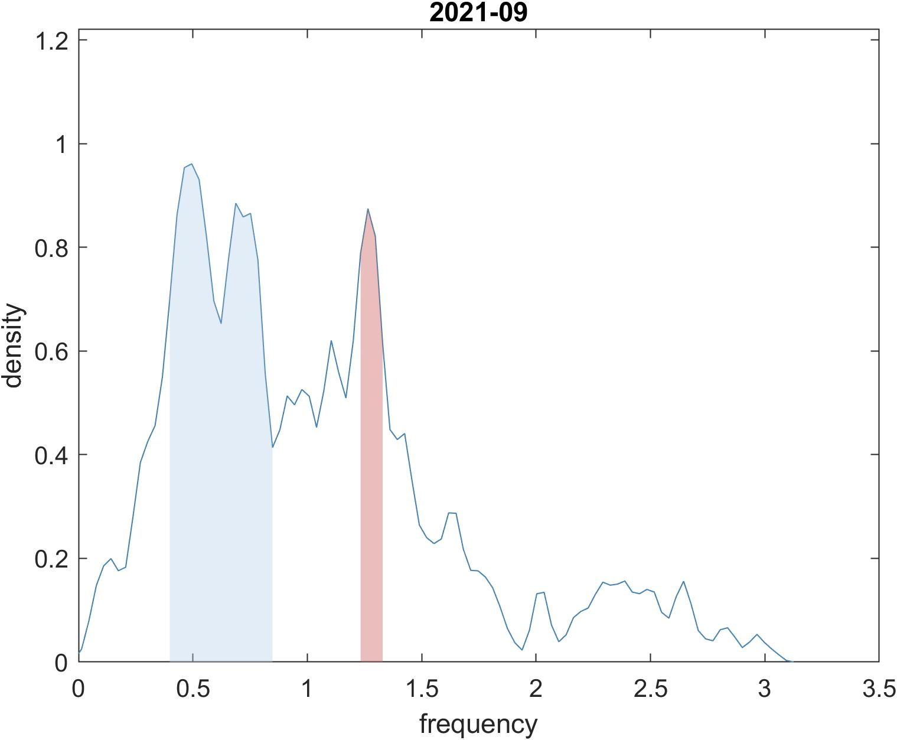
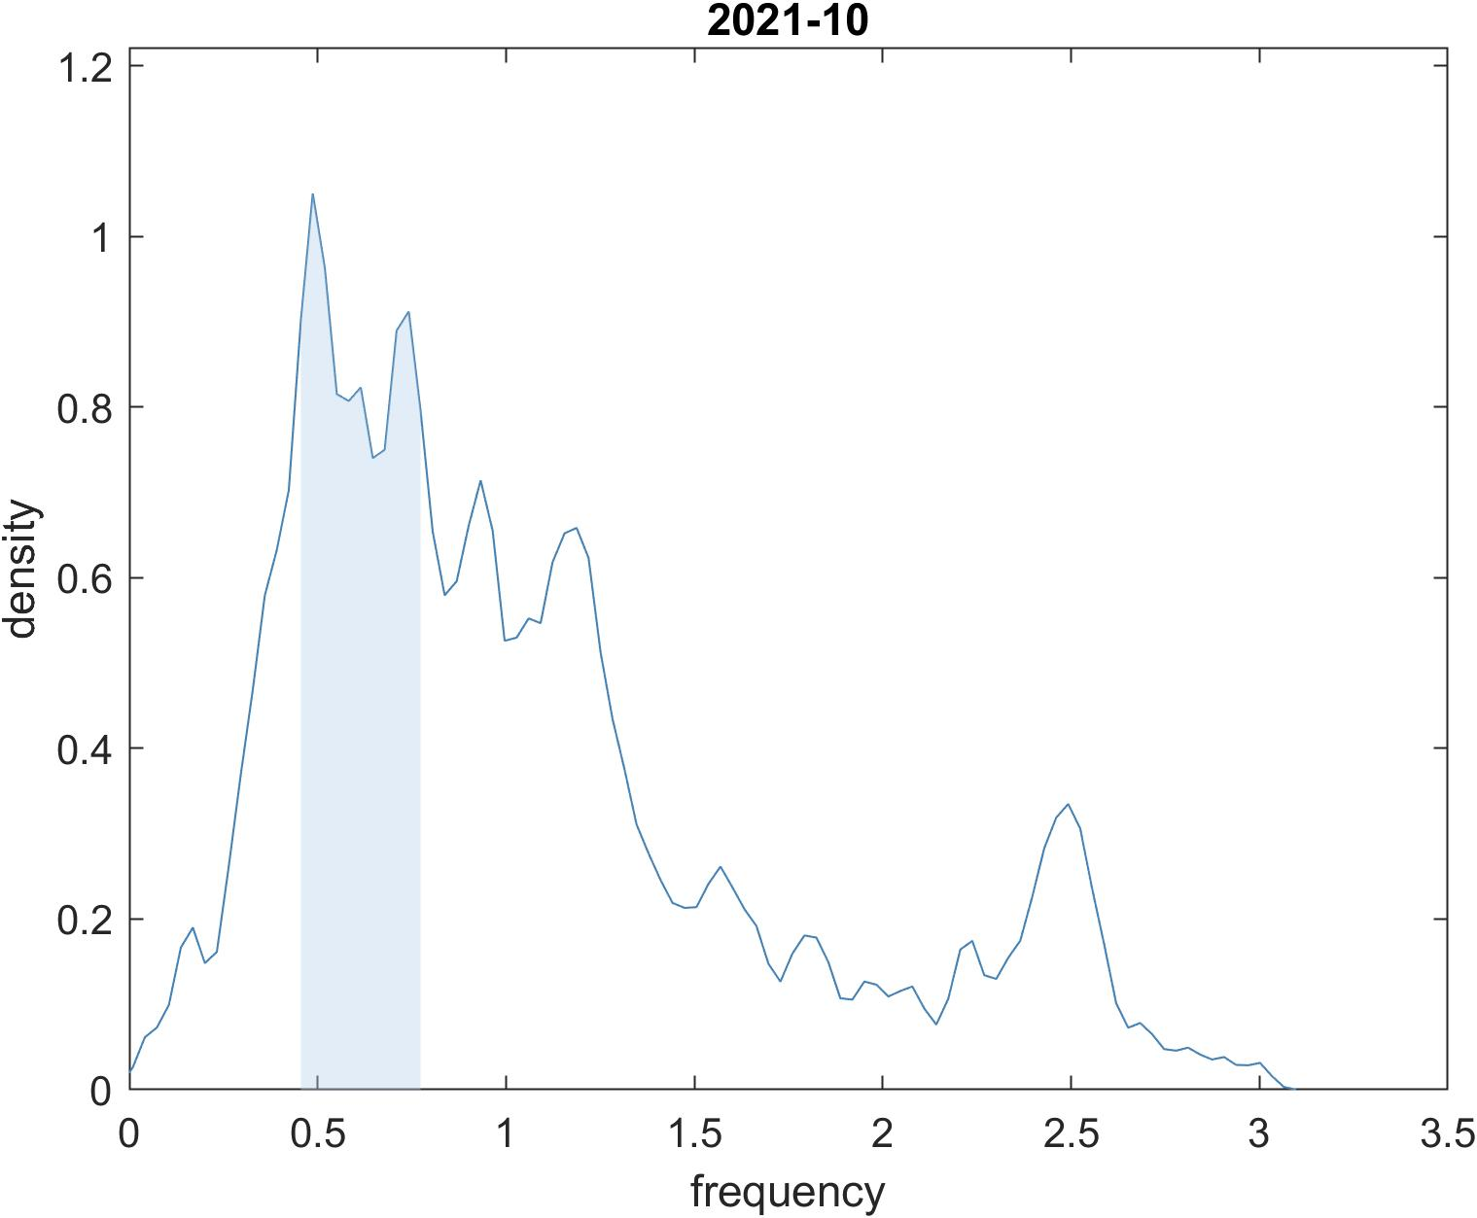
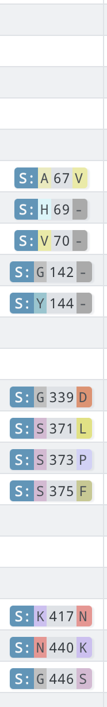


0.543
0.7336 1.40
0.487
0.742
0.463 0.720
1.265
around 145 sites
around 155 sites, including sites 19, 26, 27, 29, 67, 69, 70, 140, 141, 142, 144, 145, 210, 211, 339, 417, 440, 446, 496, 501, 505, 547, 677, 679, 614, 681, 764, 796, 856, 954, 969,
delta’s sites
around 125 sites
around 40 sites. besides sites of interest, sites 24, 69, 143, 210, 339, 373, 405, 681, 796, 982 is included
2021-09: delta 0.68, 0.48
2021-10: delta 0.69
2021-11: delta 0.6

Slide 11

0.701
0.472
around 150 sites

Slide 12

2021-11

Slide 13




2021-11
adding bandwidth

Slide 14


2020-08
2020-09
2020-10
2020-11
2020-12
2021-01

Slide 15

2021-02
2021-03
2021-04
2021-05
2021-06
2021-07

Slide 16

2021-08
2021-09
2021-10
2021-11
2021-12
2022-01

Slide 17



Hamiltonian lattices
Onsite Potential
Interaction Potential
Equation of motion:

Slide 18






Energy localization
discrete energy density

Slide 19


Slide 20





stacking interaction
Morse potential

Slide 21


Compare the distribution
to a harmonic lattice
u

Slide 22



Simulation
Experiment result
In the fastest experiments, additional fluctuations of the pulling force, superimposed to the these large variations related to base content, are systematically observe
With the model parameters presented previously we observe a propagation of the breaking for a force of the order of 0.012 f.u.,i.e., 19 pN while the experiment, performed at lower speed, detects forces of 10 to12 pN.

Slide 23


Whenever the energy on a site reaches a critical value, the site "relaxes" and its energy is transferred to the neighbors according to the specific rules of the model. In this way, a single relaxation can trigger other relaxations, leading to the formation of an avalanche.
self-organized criticality (SOC)
The critical state is approached dynamically without the need to fine-tune any parameter. The coupling of the local dynamical rules to a global condition drives the system into a state that is indeed described by a critical branching process

Slide 24





critical case
avalanche size distribution
$$D\left(s\right) \sim s^{−τ}$$
$$τ=1.5$$
The probability density of lifetimes of the avalanches is
$$D\left(t\right) \sim t^{−2}$$

Slide 25





Lifetime of the lineage
$$T=t−t_{0}$$
$${lineage l}_{i}$$
$${lineage l}_{j}$$

